Slide 1
CRICKET PREDICTION using Machine Learning
Under Supervision of:
Ms. Deepthi Sehrawat
Assistant Professor
Computer Science and Engineering
Amity University, Haryana
Made by Praveen

Slide 2

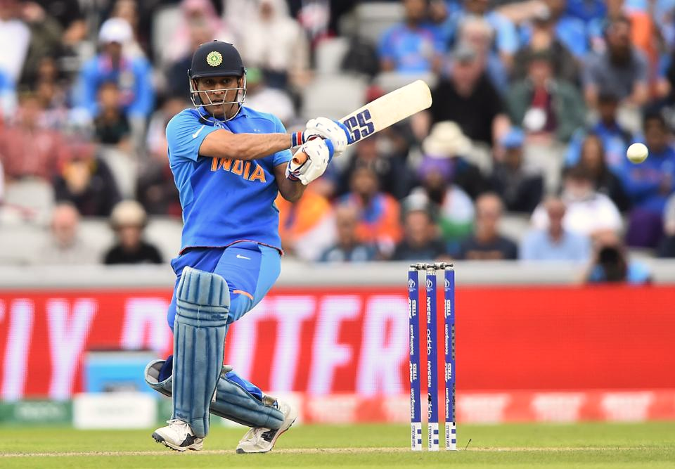
About Cricket:
Cricket is a sport that promoted coordination and teamwork. It is a game played with a bat and ball on a large ground between two teams of 11 players each. In the center of the ground there is a rectangular area called Pitch. It is 22-yard-long with a set of three wooden Stumps at each end.
One team bats, attempting to score as many runs as possible. Each phase is called as an Innings. After either ten batsmen have been dismissed or a fixed number of overs have been completed, the innings end and two teams swap role.
The winning team is the one the scores the most runs, including any extra gained, during their innings

Slide 3

01
02
03
CRICKET FORMAT
Test Cricket
One Day International
Matches last up to five days.
One inning for each team with limited over’s.
Total over’s - 50
Twenty20
Limited over’s to complete match in around 3 hrs.

Slide 4
The Seven Biggest Cricket Tournaments Ever Hosted are:
ICC Cricket World Cup
T20 World Cup
The Ashes Series
Indian Premier League
ICC Champions Trophy
Campions League Twenty20
Asia Cup

Slide 5



As there are many Tournaments of Cricket Matches, our main goal is to predicted the winner in IPL match.
The India Premier League (IPL) is a Professional Twenty20 cricket in India contested during March or April and May of every year by eight Teams representing eight different Cities in India. The league was founded by Board of Control for Cricket in India(BCCI) in 2008.

Slide 6
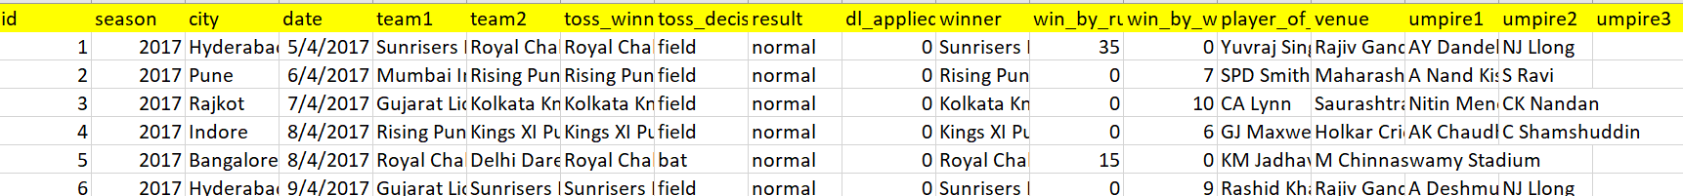
Dataset:
Used the dataset of IPL Matches held since 2008.
Downloaded the Data Set from Kaggle.
Attributes:
Id, Season, City, Date, team1, team2, toss_winner, toss_decision, result, dl_applied, winner, win_by_run, win_by_wickets, player_of_match, venue, umpire1, umpire2, umpire3
Independent Variables: Id, Season, City, Date, team1, team2, toss_winner, toss_decision, venue
Dependent Variable: winner

Slide 7
Wining of the Team may depend on various Factors
Teams
City
Toss Decision
Toss Winner
Venue

Slide 8

Basic Steps to predict the winner using Machine Learnig
Data Collection
Collecting appropriate dataset that suits our goal.
Data Preprocessing and Cleaning
Data should not contain any null values or any outliers, as they can lead to wrong prediction.
Analyzing the Data
We should understand the data properly
Choosing a Model
Choosing model with more accuracy for predictions
Training The Model
We should train the model to get appropriate result
TESTING and PREDICTIONS

Slide 9
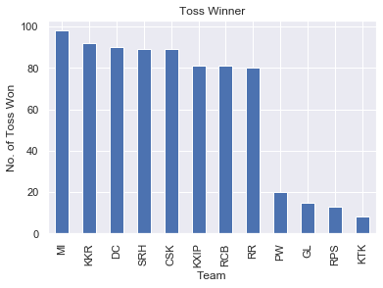
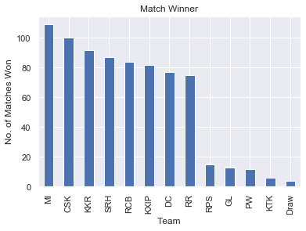
Analyzing:
This Graph Shows how many times a team won the toss.
This Graph Shows how many times a team has Won the Match.

Slide 10
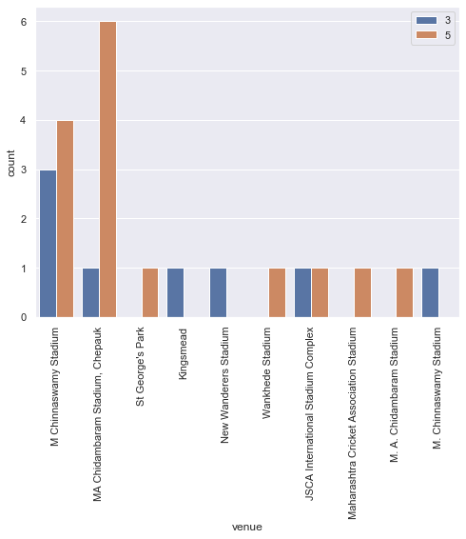
This Graph tells that Venue can also the factor for Wining of a Team

Slide 11
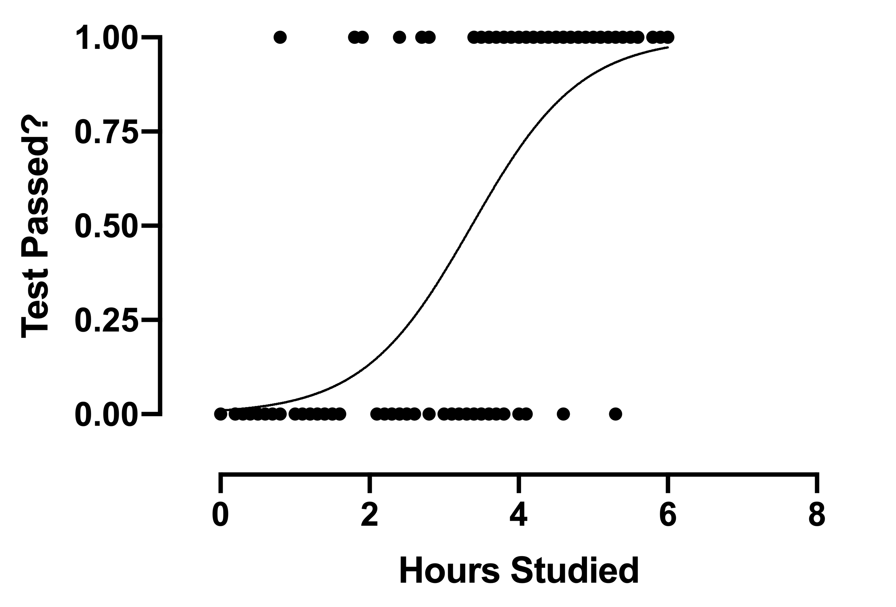

Models Used:
Logistic Regression: it is a statistical analysis that is used to predict the outcome of a dependent variable using the Independent Variables. it is also a classification Algorithm.
Naïve Bayes Algorithm is a probabilistic machine learning model that’s used for classification task. This classifier is based on the Bayes theorem.
Bayes Theorem: P$\left(A | B\right)$ = $\frac{P\left(B | A\right) ∗P(A)}{P(B)}$

Slide 12
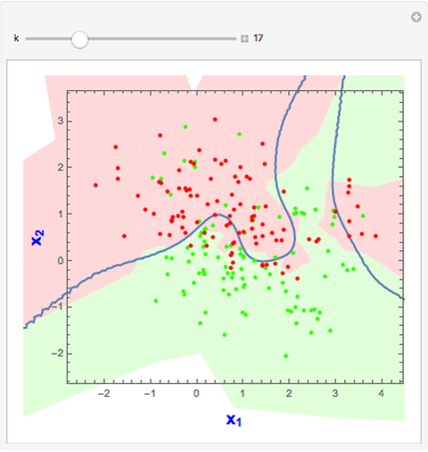
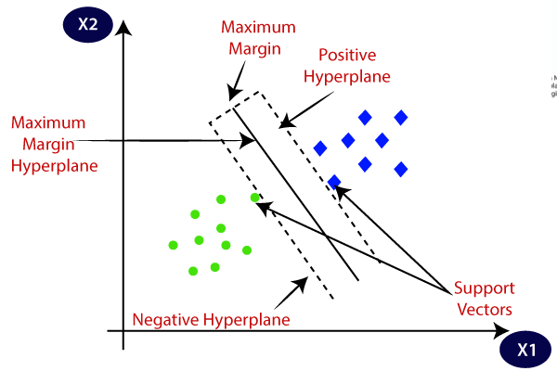
k-nearest neighbors algorithm ( KNN) – it is a non – parametric method. Classification is done by a majority vote to its neighbors. It is a SUPERVISED LEARNING method in Machine Learning.
SVM or Support Vector Machines - is a SUPERVISED LEARNING method in machine Learning which is used for classification Method. It is based on the concept of decision planes that defines decision boundaries,
*Decision plane is one that separates between a set of objects having different class memberships.

Slide 13
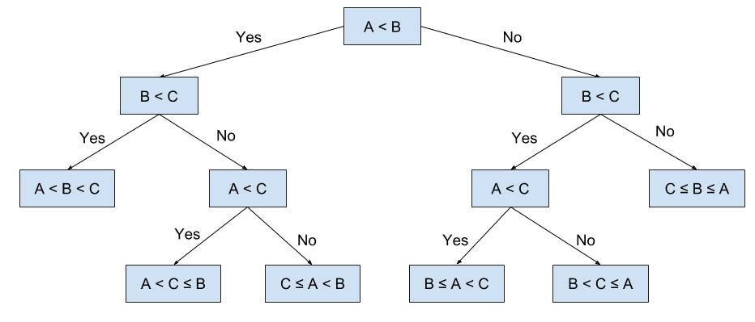

Decision Tree : it is a Tree which is developed based on certain decisions taken by the algorithm in accordance with the given data that it has been trained on. It is using the features in the given data to perform Supervised Learning and develop a tree-like structure.
Random Forest: it a SUPERVISED LEARNING method. It is a type of ensemble machine learning algorithm called Bootstrap Aggregation or bagging. is a classifier that contains several decision trees on various subsets of the given dataset and takes the average to improve the predictive accuracy of that dataset.

Slide 14
Flow Chart of Models with their Accuracy:
Sklearn
Linear Model
Naïve Bayes
Neighbors
Tree
Ensemble
LogisticRegression
GaussianNB
KNeighborsClassifier
SVM
SVC
DecisionTreeClassifier
RandomForestClassifier
31.35%
18.78%
84.39%
43.65%
86.65%
86.65%
**As Random Forest Gives more Accuracy, it can be further used for Predictions

Slide 15
Comparison of Evaluation Metrics'(EM) of different Model
 | Logistic Regression | Naive Bayes | KNN | SVM | Decision Tree | Random Forest Classifier
Precision Score | 0.55 | 0.54 | 0.84 | 0.78 | 0.88 | 0.88
Recall Score | 0.53 | 0.53 | 0.84 | 0.51 | 0.86 | 0.87
F1 Score | 0.56 | 0.56 | 0.84 | 0.56 | 0.87 | 0.88
Model
EM

Slide 16
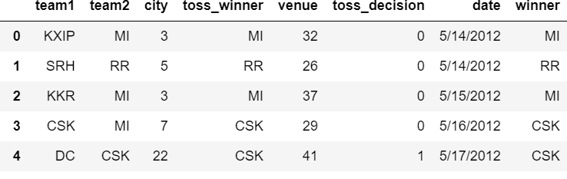
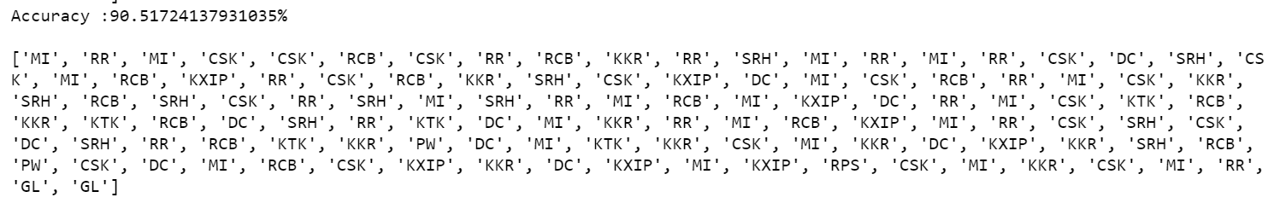
Prediction:
For Prediction, I used Test Data Set:
Shape=(116x8)
Predicted Values:

Slide 17
References:
https://www.towardsdatascience.com/
https://www.Kaggle.com/nowke9/ipldata
https://www.sci-hub.com/
https://www.analyticsvidhya.com/glossary-of-common-statistics-and-machine-learning-terms/
http://www.cricinfo.com
https://www.sciencedirect.com/science/article/pii/S1877050916304653?via%3Dihub

Slide 18
THANK YOU

